Slide 1

Our Children, Our Future
An Enterprise Analysis and Population Study of Tennessee Public Schools

Slide 2
One Why and Two Objectives
Why?
To create an enterprise dashboard that analyzes all of Tennessee’s 1,758 public schools across 149 school districts
To conduct a population study that utilizes census data to determine how representative school are of their communities

Slide 3

Data sources and Methodology
Data sources
Tennessee Dept of Education (TDOE)
US Department of Education (EDGE Open Data)
US Census Bureau (ACS 2019 5-year)
SchoolDigger.com School and District Rankings
Technologies utilized
Python
Tableau
Excel

Slide 4
Part 1
Enterprise Dashboard

Slide 5
Part 2
Community Representation in Public Schools

Slide 6
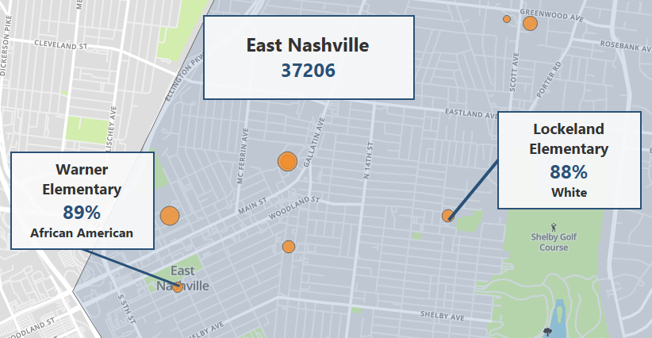
A Tale of Two Schools
Beginning in August 2020, WPLN’s ‘The Promise’ podcast did a series of episodes profiling two elementary schools in East Nashville
Only a mile apart, Warner Elementary is nearly 90% black and under resourced. Lockeland Elementary, by contrast, is nearly 90% white and more affluent

Slide 7
The Question:
To what extent do public schools represent their communities?

Slide 8

Methodology: Data Source Analysis
The percentage value representation of race/ethnicities in schools were compared to the same demographics of the school age population (5 to 19 yrs) across Tennessee’s 2,520 zip codes
ACS 2019 5-year surveys and TDOE’s 2019 School Level Profile (demographic) data tables were used for this comparison

Slide 9
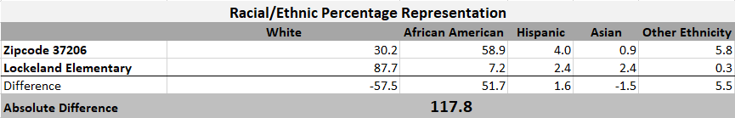
Methodology: Comparison Score Calculation
A Community Comparison Score (CCS) was calculated by summing the absolute difference between a school and zip code demographics as shown above
A school classification (Not Representative, Partially Representative, Representative) was then assigned based on the CCS’s standard deviation from the mean score
Not Representative: 2 standard deviations above the mean
Partially Representative: between 1 and 2 standard deviations above the mean
Representative: within 1 standard deviation of the mean
Notes:
Go to Zip code Dashboard here

Slide 10
Findings
Statewide, 5.8% (102 out of 1,759 total schools) had a CCS designation of ‘Not Representative’, while 8.8% (155 schools) were ‘Partially Representative’
Representation was more problematic in the following counties:
County | % Not Representative | % Partially Representative
Shelby | 29% | 18%
Hamilton | 15% | 15%
Davidson | 8% | 21%

Slide 11
Conclusions
While community representation in schools does not appear to be a prevalent issue statewide, it has a much greater prevalence in more populous counties, particularly those of Shelby, Hamilton, and Davidson
Continued monitoring of representation in schools must be undertaken by both researchers and policy makers to ensure that all schools are adequately inclusive, well resourced and optimally performing academically

Slide 12
Thank You
Comments / Questions / Feedback

